Slide 1
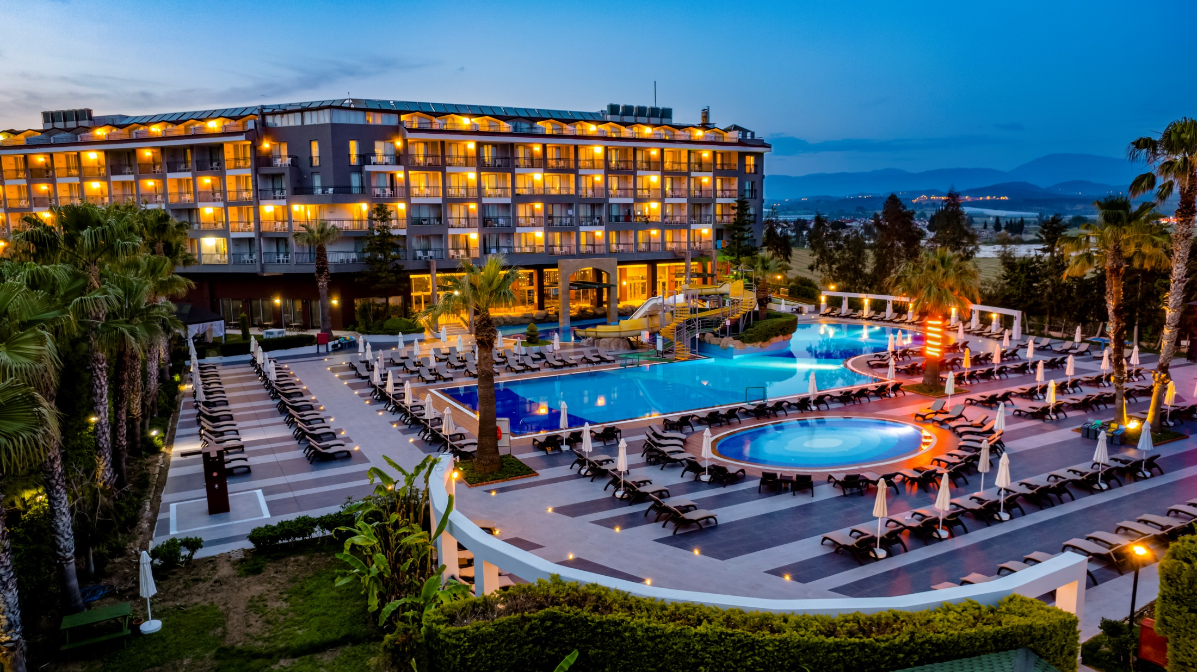

SUSTAINABILITY REPORT

Slide 2
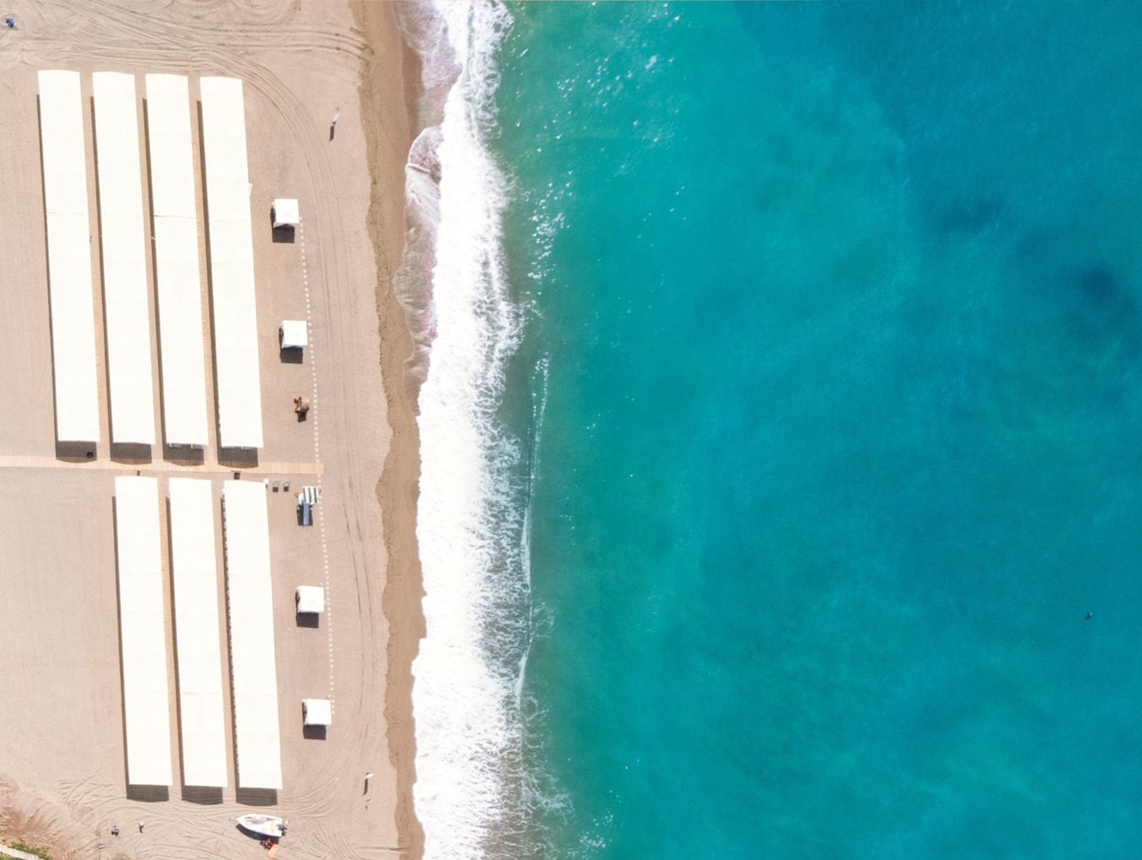

REPORT SCOPE
Our Sustainability Policy
Our Sustainability Message
Sustainability Action Report
Our Culture, Heritage and Values
Our Environmental Activities
Our Environmentally Friendly Purchasing Activities
Children and Individuals with Special Needs
Sustainability Report
Waste Management
Guest Satisfaction
Our Contribution to the Regional Economy
Consumable Material Change Amounts
Disposable Material Consumption Amounts
2

Slide 3
OUR SUSTAINABILITY POLICY
OUR PURCHASING POLICY
We prefer the materials we purchase with "recycling" and "environmentally friendly" labels,
We contribute to the regional economy by working with local suppliers and try to reduce our carbon footprint,
We are careful not to choose unnecessary packaged products,
We comply with laws and regulations in all our activities.
3

Slide 4
OUR ENVIRONMENTAL PROTECTION AND WASTE MANAGEMENT POLICY
We pay attention to our activities to reduce our waste at its source,
We separate our waste according to type and deliver it to licensed companies,
We aim to reduce the amount of waste,
We use hazardous substances and chemicals when and as needed,
We raise the awareness of our employees and raise the awareness of our guests on environmental awareness, Waste Management and Zero Waste.
We adopt the principle of working efficiently and economically for the effective use of our natural resources,
We raise
4

Slide 5
OUR EMPLOYMENT, EQUALITY AND HUMAN RIGHTS POLICY
We contribute to the development of the regional economy by providing employment to local people,
We create a fair and peaceful working environment for our employees, where no discrimination is made and equal opportunities are provided,
We care about the health, safety and welfare of all our employees, regardless of gender,
We support women's participation in the workforce and provide equal opportunities,
We act with the policy of "equal pay for equal work" without discrimination of gender,
We provide the necessary environment to benefit from career opportunities equally,
Vulnerable groups should not be subjected to any form of abuse, harassment, discrimination, suppression, coercion, slander, etc. is not allowed to be exposed to situations,
We create an environment where the opinions of all our employees are treated respectfully,
Gender, language, race, age, socio -economic status, educational status, ethnic
5

Slide 6
OUR CULTURAL AWARENESS POLICY
information so that our guests can access the natural and cultural heritage, local products and services in our region ,
It ensures that local culture, traditions and customs are protected; We do not allow discriminatory activities regarding views, ethnicity, beliefs and vulnerable groups. We know that visitors, who come both for touristic purposes and for work, contribute to regional development with their different cultures and that hospitality should be shown,
We support the preservation of historical and archaeological monuments,
Knows our geography and local society well and respects their historical values and traditions; We contribute to economic, social and cultural development .
6

Slide 7
OUR ACCESSIBILITY POLICY
We carry out our activities by considering the convenience of individuals with special needs (disabled people, children, etc.) to access our products and services,
We provide an environment in which our guests and employees who need special protection in our facility will not be harmed in any way, and where all their problems can be easily communicated and resolved,
We constantly monitor and measure our practices and targets in our sustainability management system and initiate, plan and finalize our corrective actions when necessary.
We care about accessibility, health and safety standards for all our guests, staff and visitors with special needs, physical sensitivities and difficulties, and we organize the environments where they spend their holidays or work in line with these standards .
7

Slide 8
OUR CHILDREN'S RIGHTS POLICY
We do not employ child labor in our hotel and we expect the same sensitivity from all our business partners.
We provide environments/opportunities within the facility that contribute to the development of children, where they can easily express their thoughts, wishes and feelings, and where they feel free and comfortable.
We give service priority in our presentation areas,
We provide awareness training to our staff on child rights/abuse.
We try to raise awareness of families' attitudes and behaviors towards their children, and signs of physical-verbal-psychological violence or neglect.
We make sure that children are under adult supervision in the activities they participate in,
We support relevant projects on the protection of children's rights,
When we witness suspicious behavior regarding children, we first inform the hotel management and, when deemed necessary, ask for help from the Social Support Line .
8

Slide 9
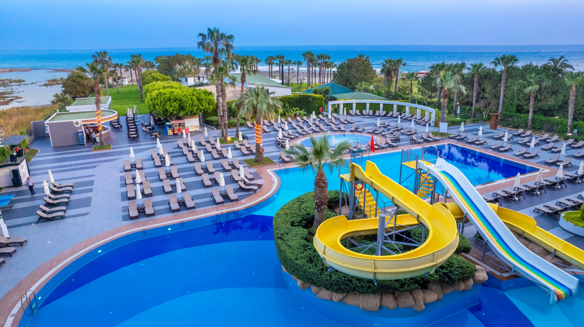
Our Sustainability Message;
Dear Guests, Business Partners and Employees,
As
Washington Resort Hotel & SPA, we are aware of the climate crisis caused by global warming affecting our world and we are eager to carry out
9

Slide 10
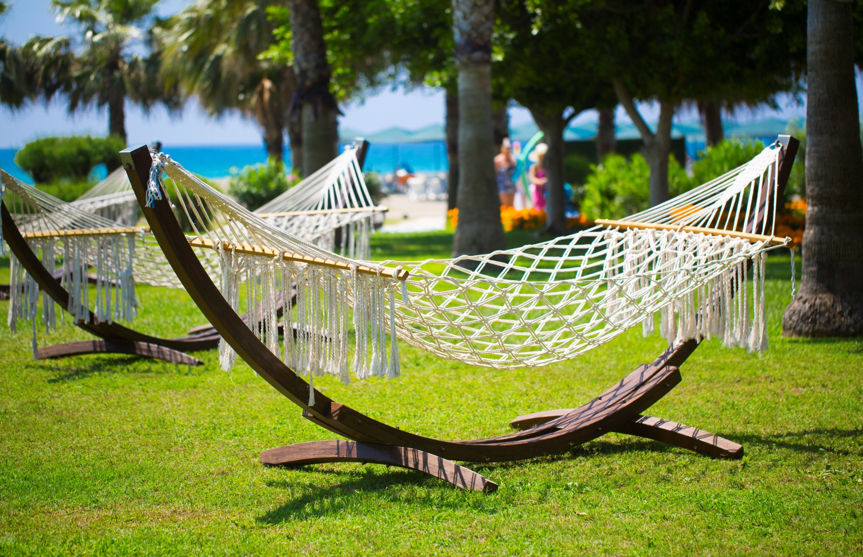
We do not find it right to limit the definition of sustainability only to the environment. In addition, we aim to protect and develop our natural resources, history and cultural values. The biggest reason why we embrace sustainability is; We know that the region will develop economically and socially. In line with these goals, we realize our vision without compromising guest satisfaction .
10

Slide 11
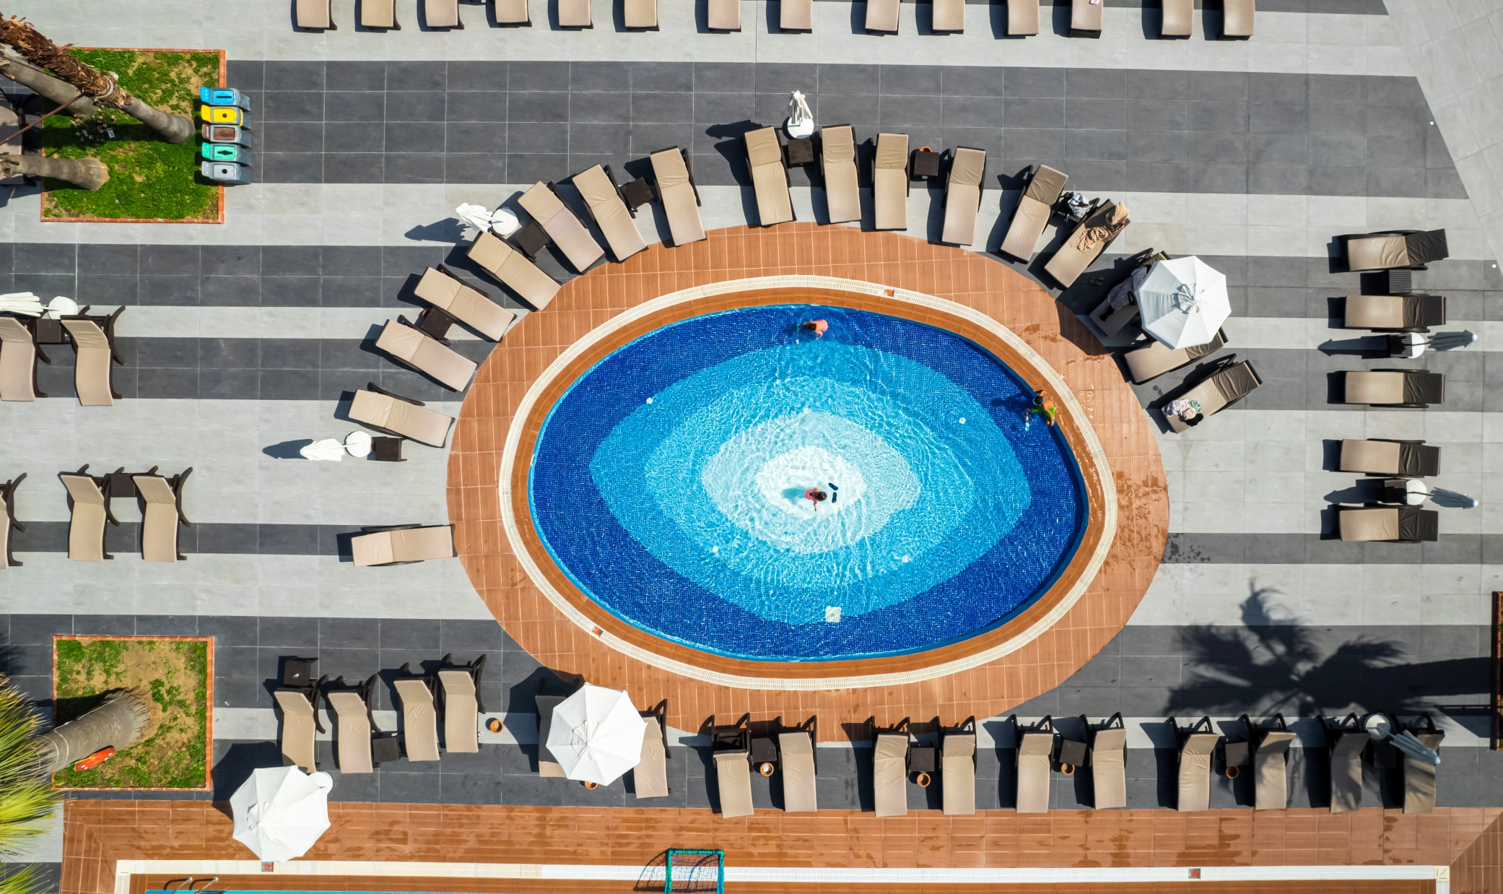
SUSTAINABILITY ACTION REPORT
11

Slide 12
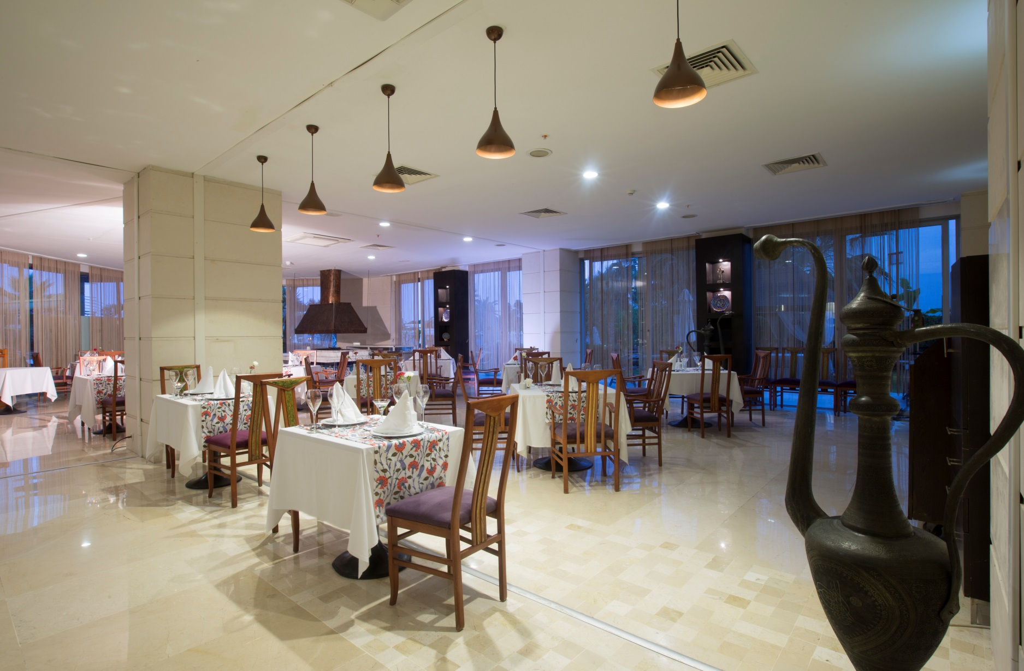
OUR CULTURE, HERITAGE AND VALUES;
12

Slide 13
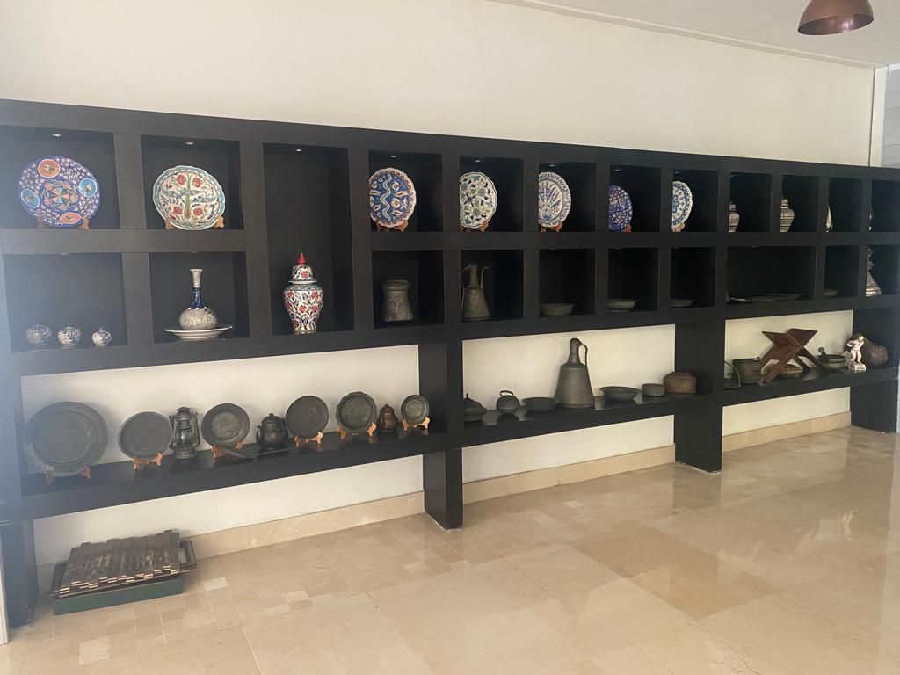
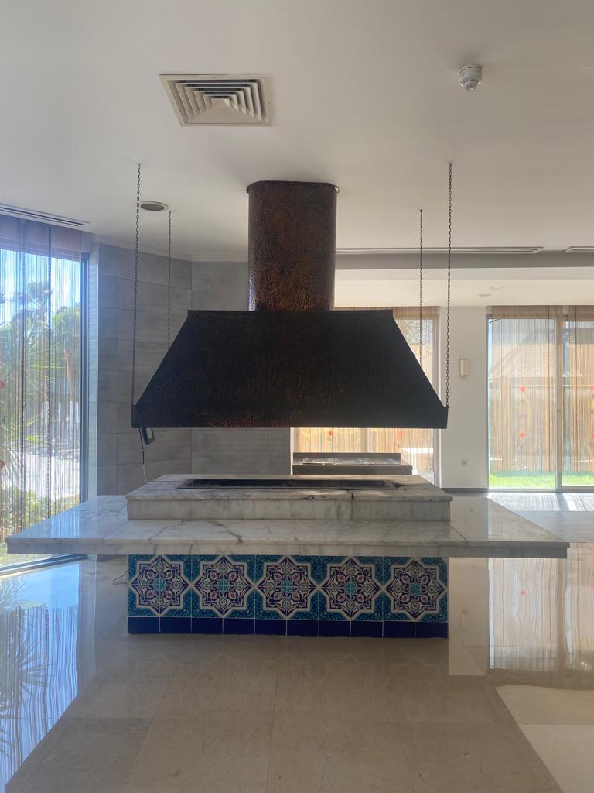
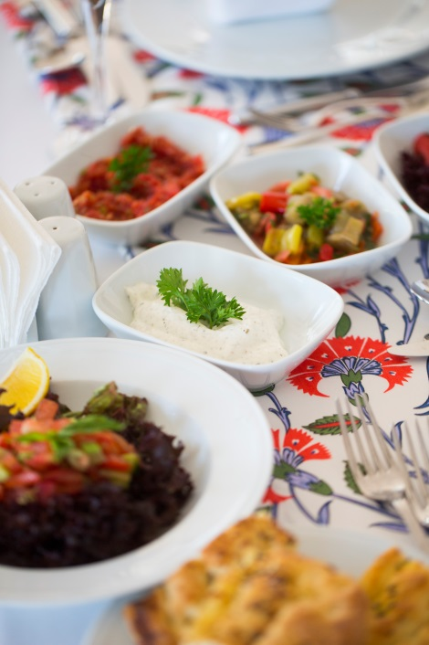
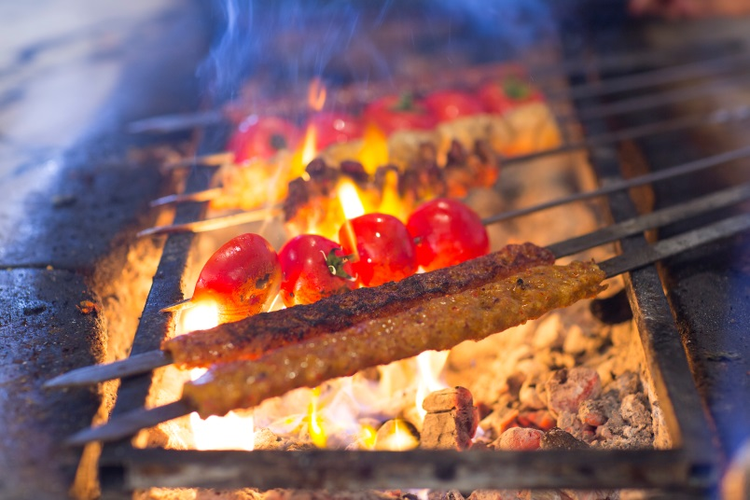
Our Culture, Heritage and Values;
an A La Carte restaurant in our facility, whose name is Sultan Ocakbaşı .
Sultan Ocakbaşı In our restaurant , we show our guests the Turkish culture in terms of both taste and ambience by exhibiting elements of our culture with objects such as pitchers, tiles, old copper pots and the fireside in the restaurant.
13

Slide 14
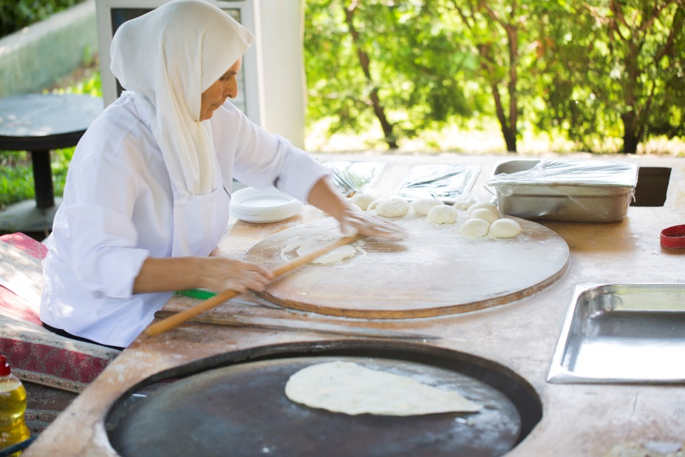
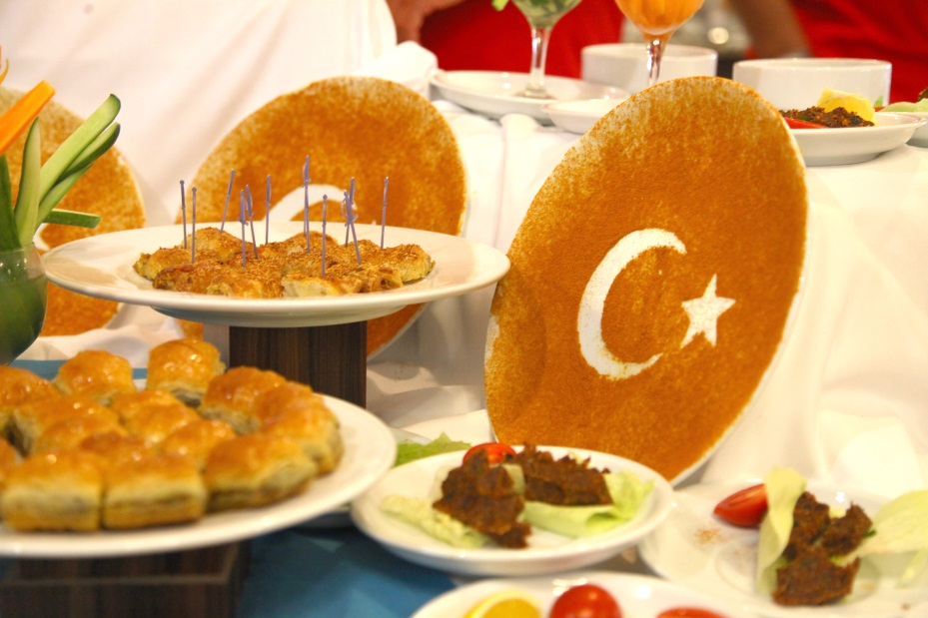
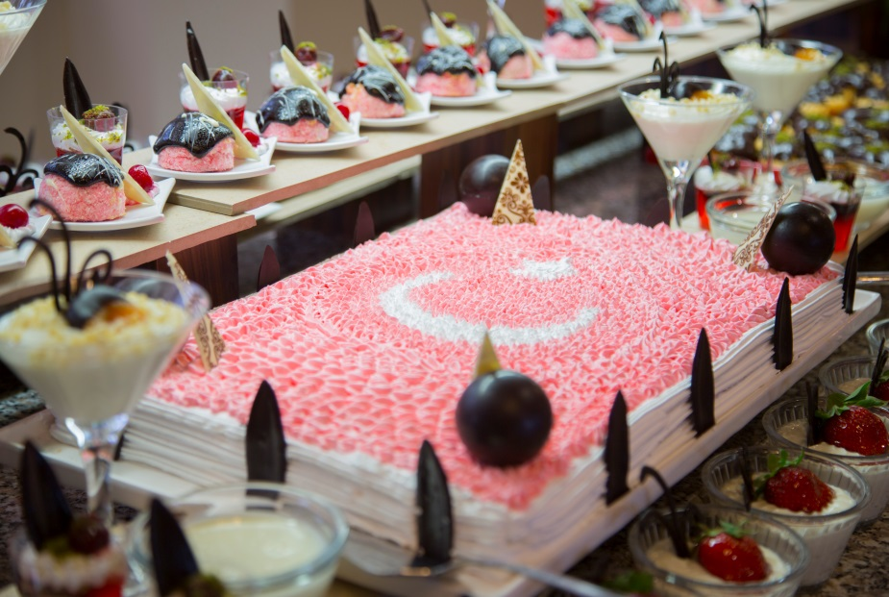
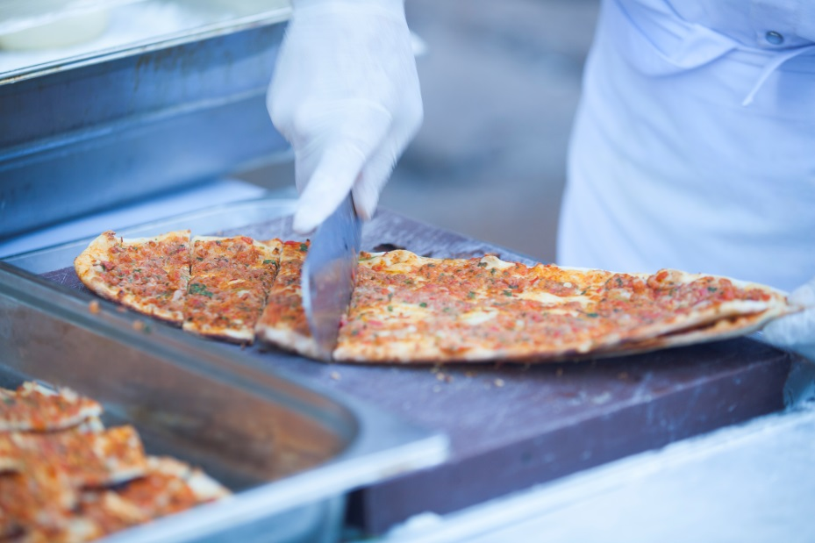
Our Culture, Heritage and Values ;
We enable our guests to taste our delicacies by serving local dishes at weekly organized Turkish nights.
We offer pancakes and pita, which are among the most popular flavors of our culture, as snacks throughout the day.
14

Slide 15
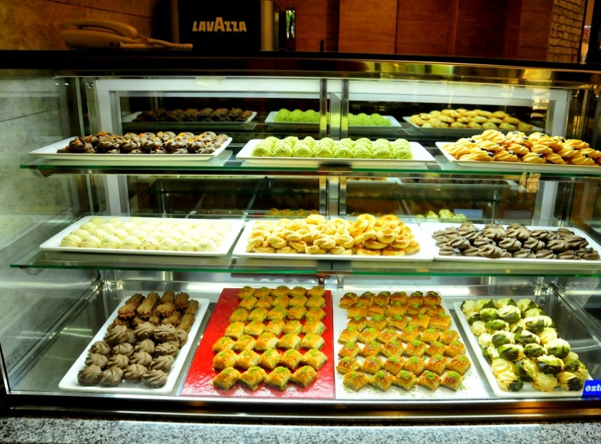
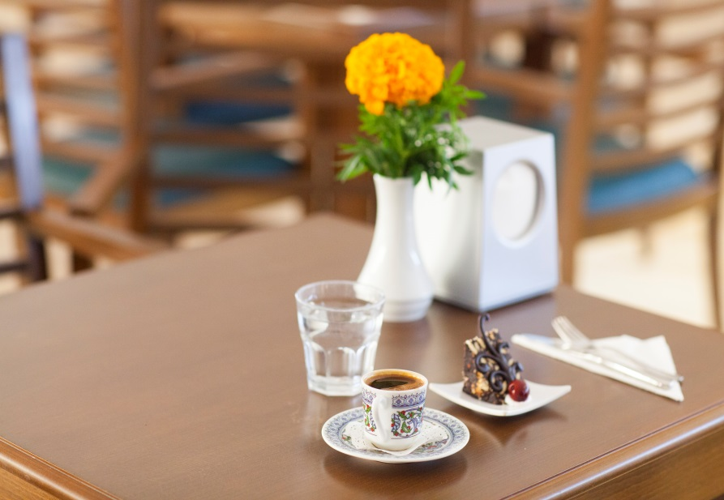
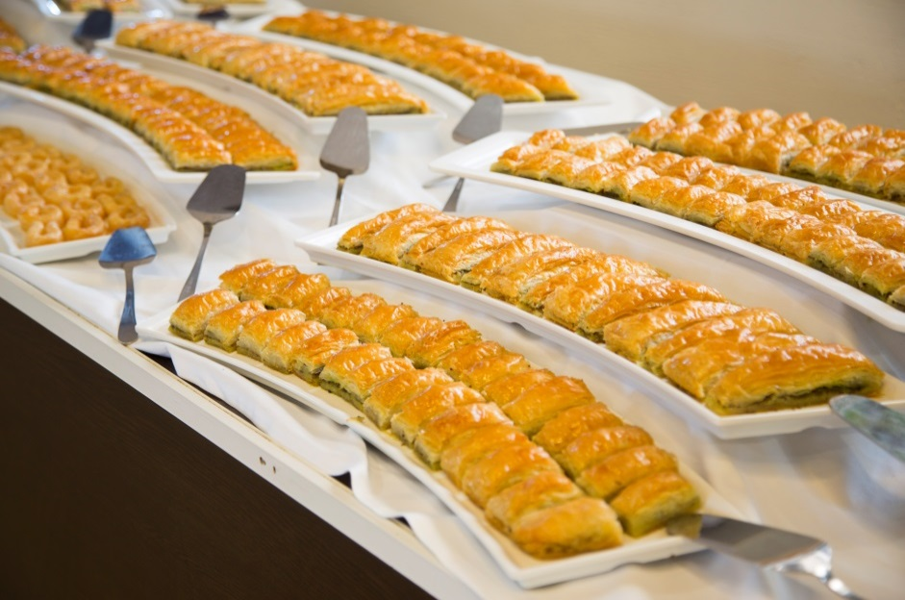
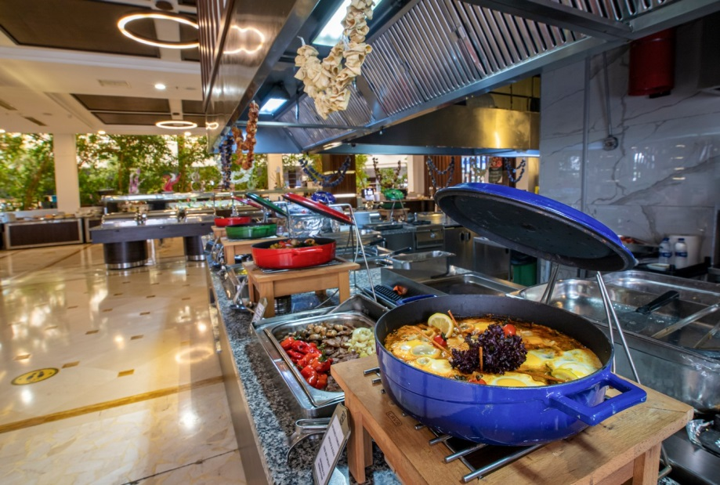
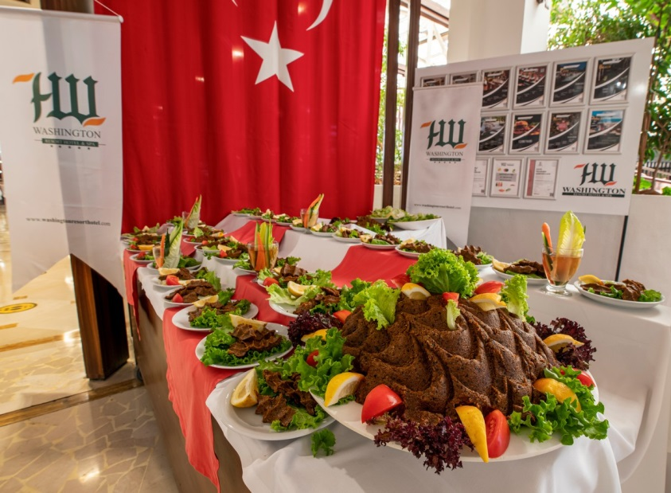
Our Culture, Heritage and Values;
Turkish coffee is served to our guests in our Patisserie section.
15

Slide 16
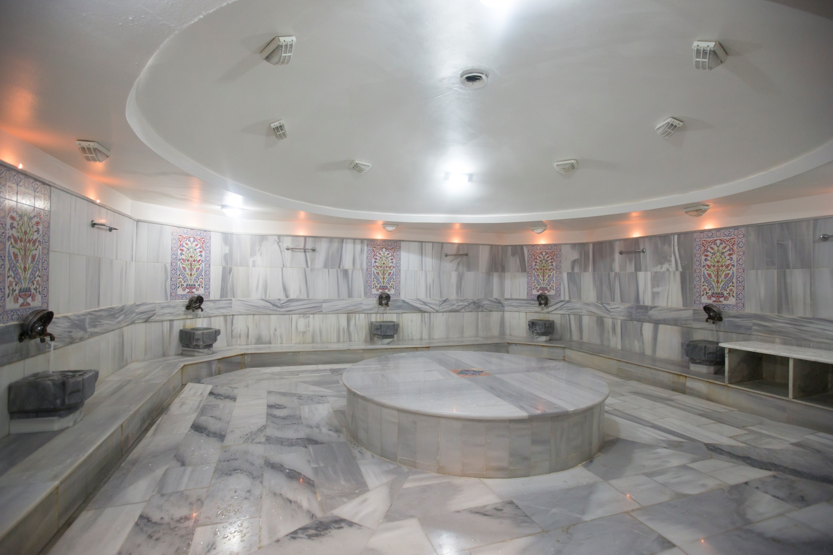
Our Culture, Heritage and Values;
our guests can benefit from, reflect our culture . ( pouch, foam etc. )
16

Slide 17
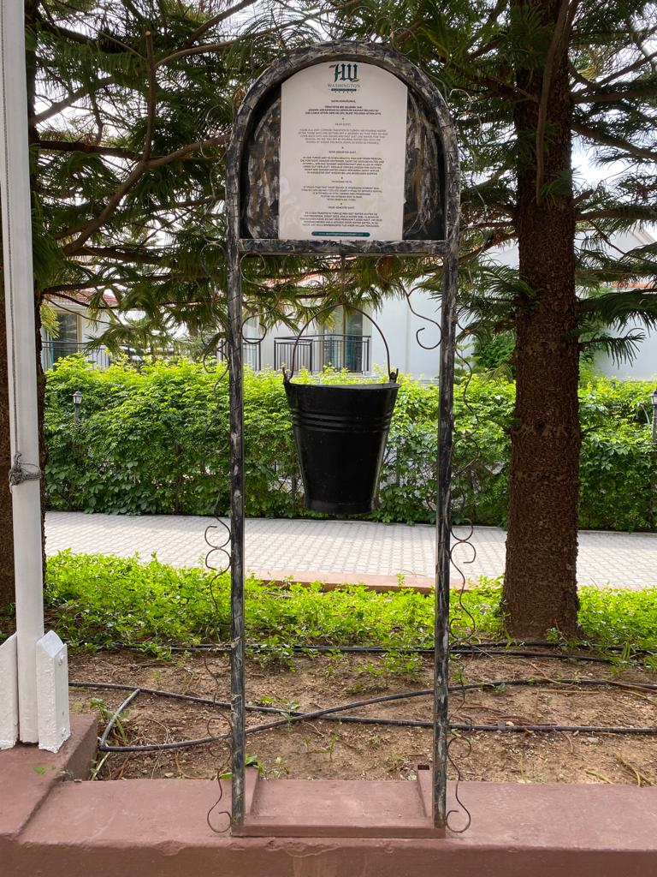
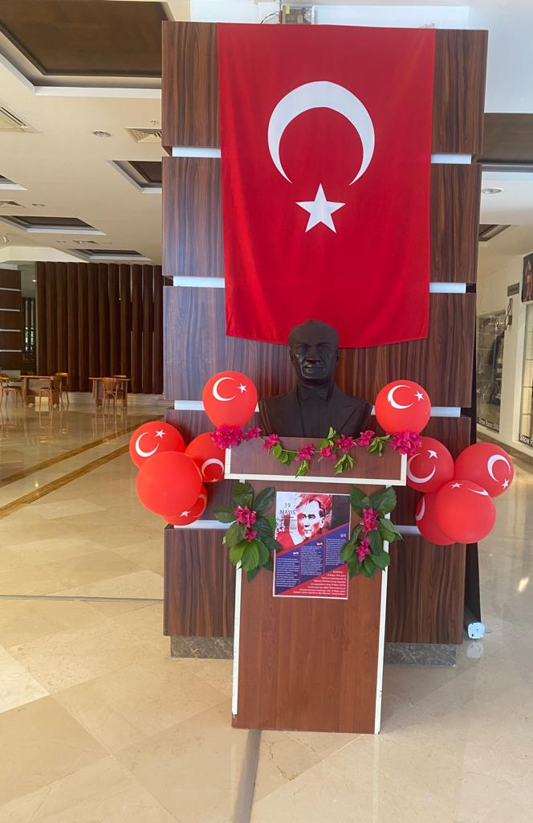
Our Culture, Heritage and Values;
We introduce our tradition of pouring water after the departing person to our guests with the bucket and writing in front of our door.
We celebrate our national holidays and introduce them to our guests.
17

Slide 18
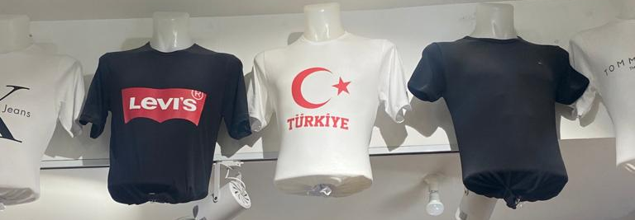
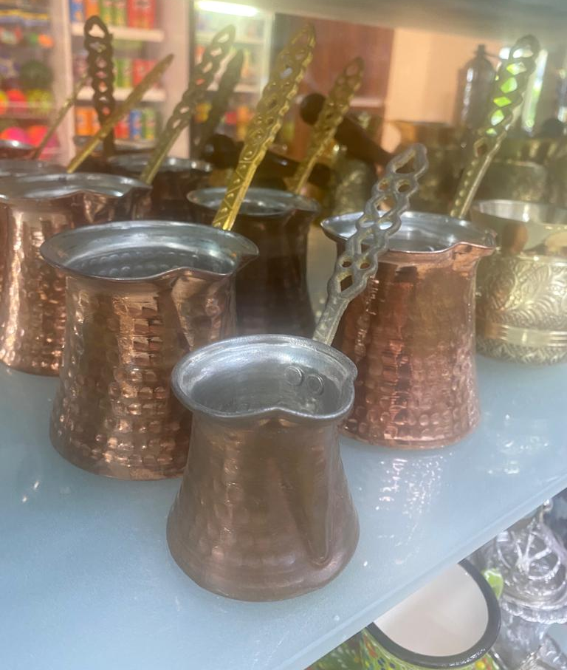
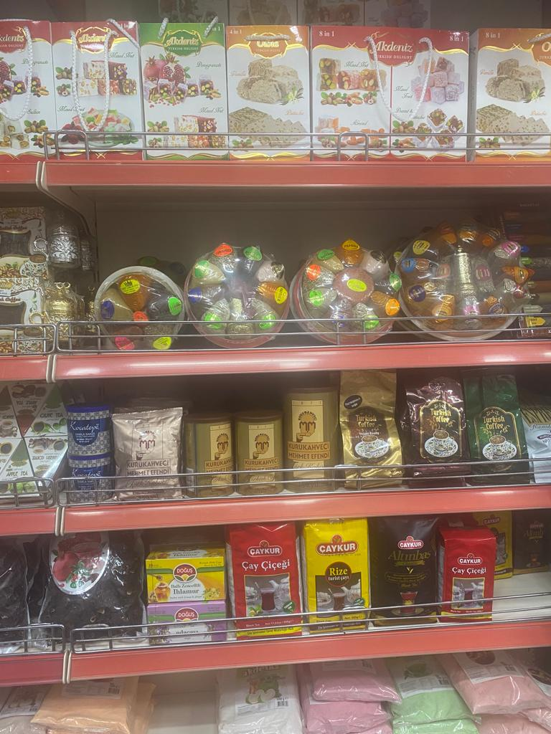
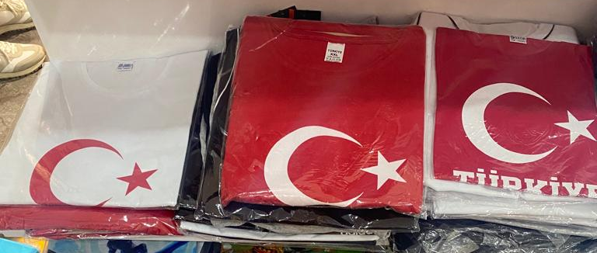
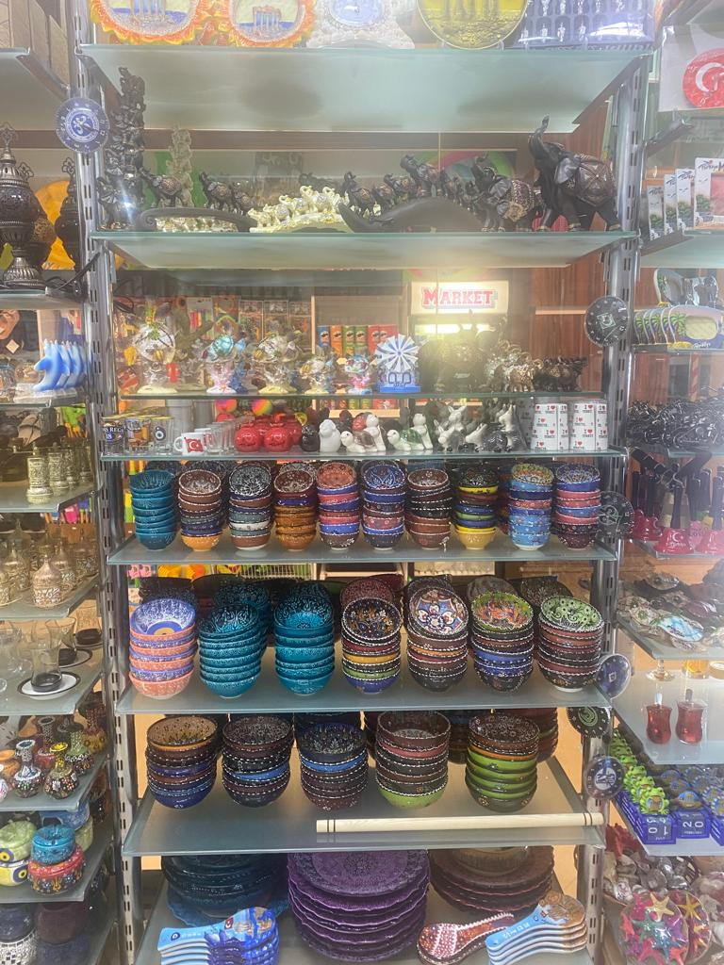
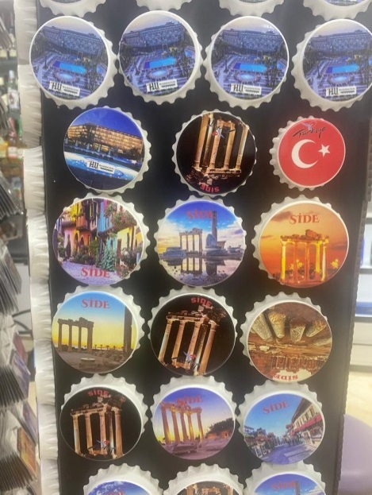
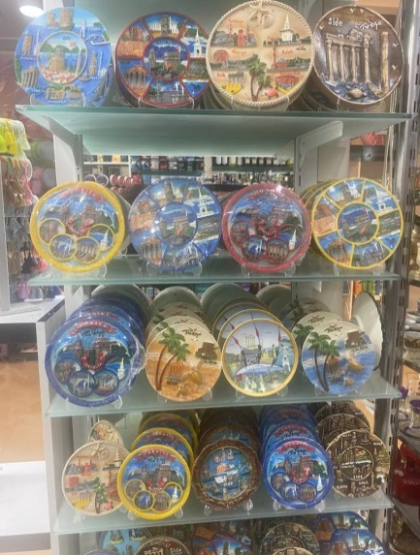
Our Culture, Heritage and Values ;
Various products belonging to our culture are sold in the bazaar located within our facility .
18

Slide 19
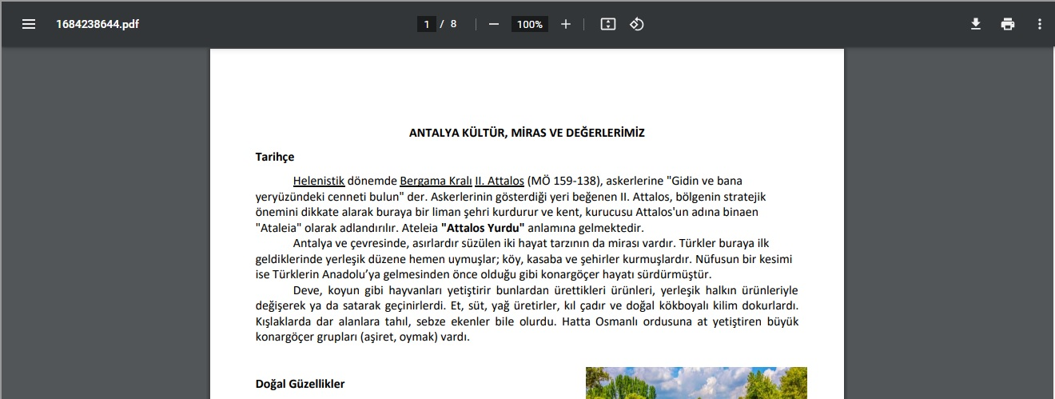
Our Culture, Heritage and Values ;
our guests about Antalya on our official website . We also share our informative articles explaining our Culture, Heritage and Values in our personnel areas.
19

Slide 20
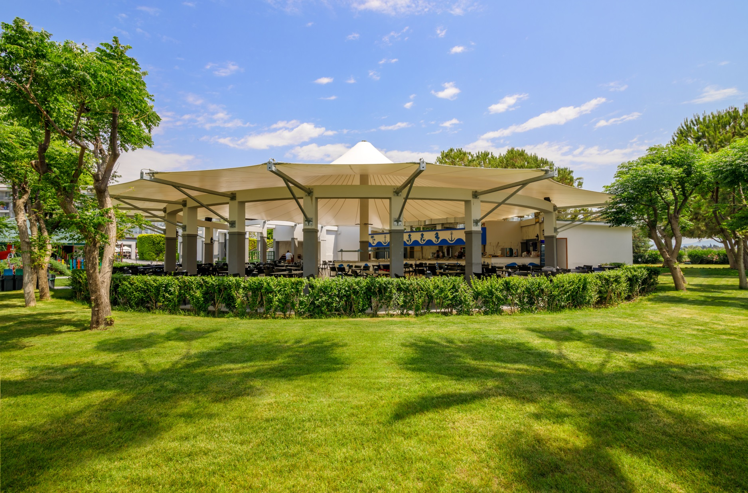
OUR ENVIRONMENTAL ACTIVITIES;
20

Slide 21
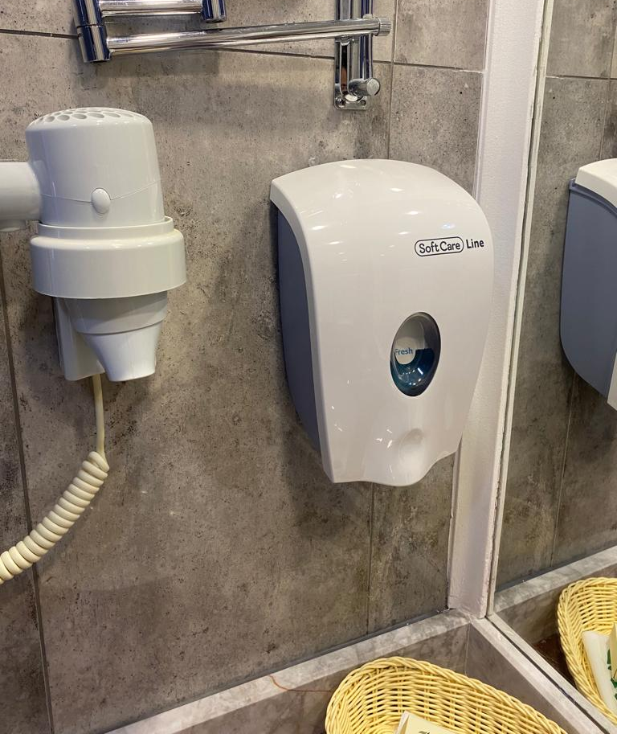
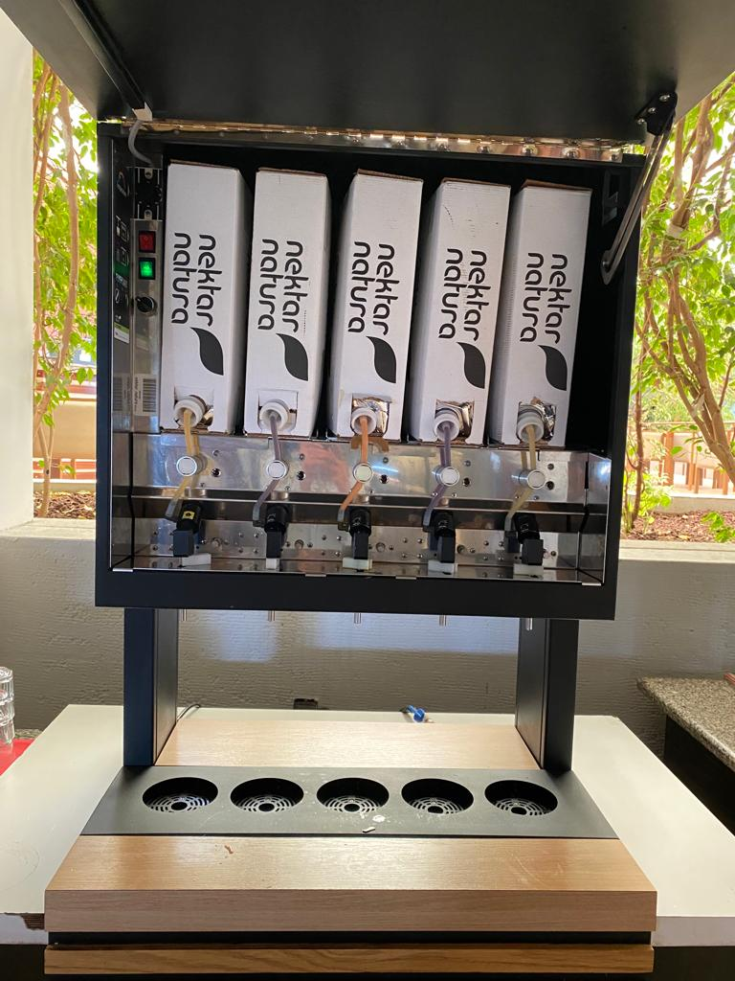
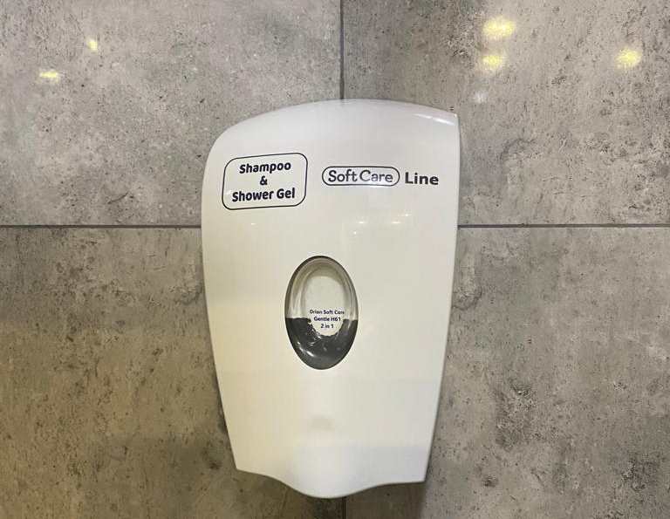
Our environmental activities;
supplier companies, we check whether they are local, environmentally friendly and comply with the concept of fair trade, and we make the evaluation according to these criteria.
our drinks in postmix ( min. 10 lt ) or keg (50 lt ) .
We prefer refillable dispensers instead of amenity products .
dispensers instead of tissue roll holders in our public toilets .
21

Slide 22
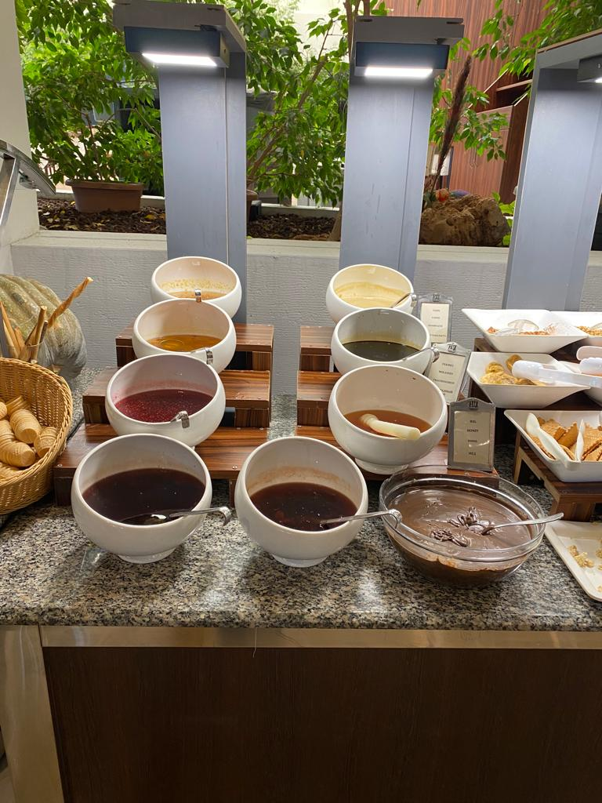
Our environmental activities;
We prefer bulk products instead of packaged products .
our suppliers locally, and we aim to reduce our waste amounts by reducing the amount of disposable products .
In 2023, cloth napkins will be offered in our restaurant only on theme nights.
22

Slide 23
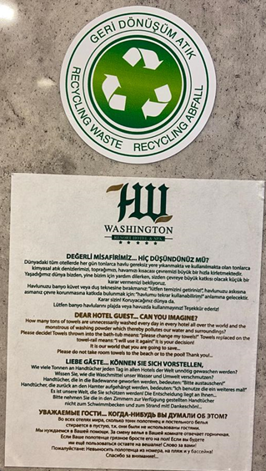
environmental activities ;
We aim to reduce our chemical and water consumption by changing our guests' towels and sheets every two days, unless requested by them.

Slide 24
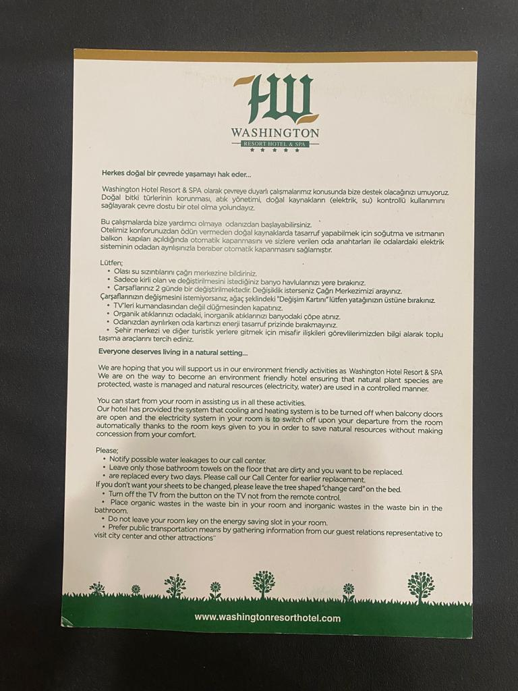
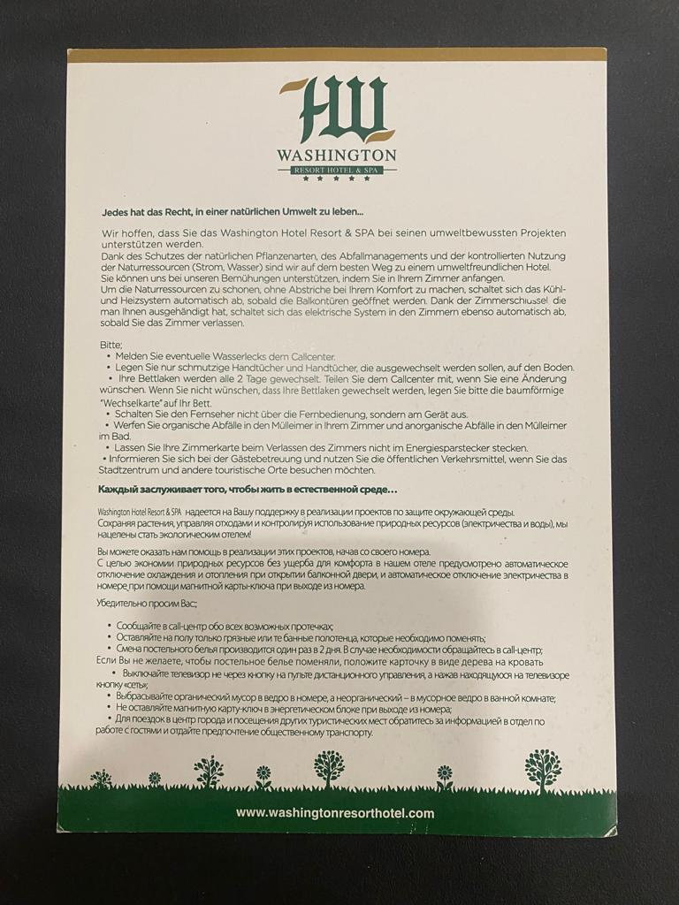
environmental activities ;
There are information cards and wall stickers in our rooms in four languages to encourage our guests to be more sensitive to our environment.
In our rooms, cooling or heating is automatically turned off when the balcony doors are opened.

Slide 25
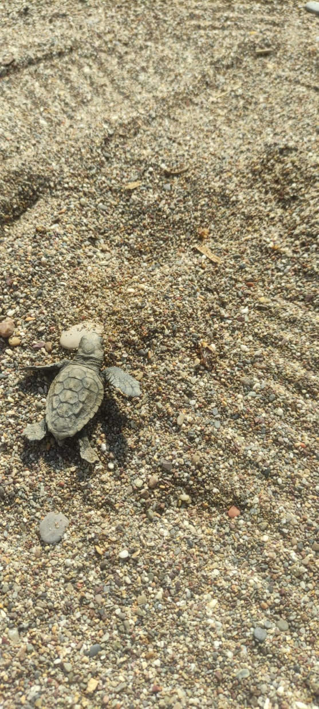
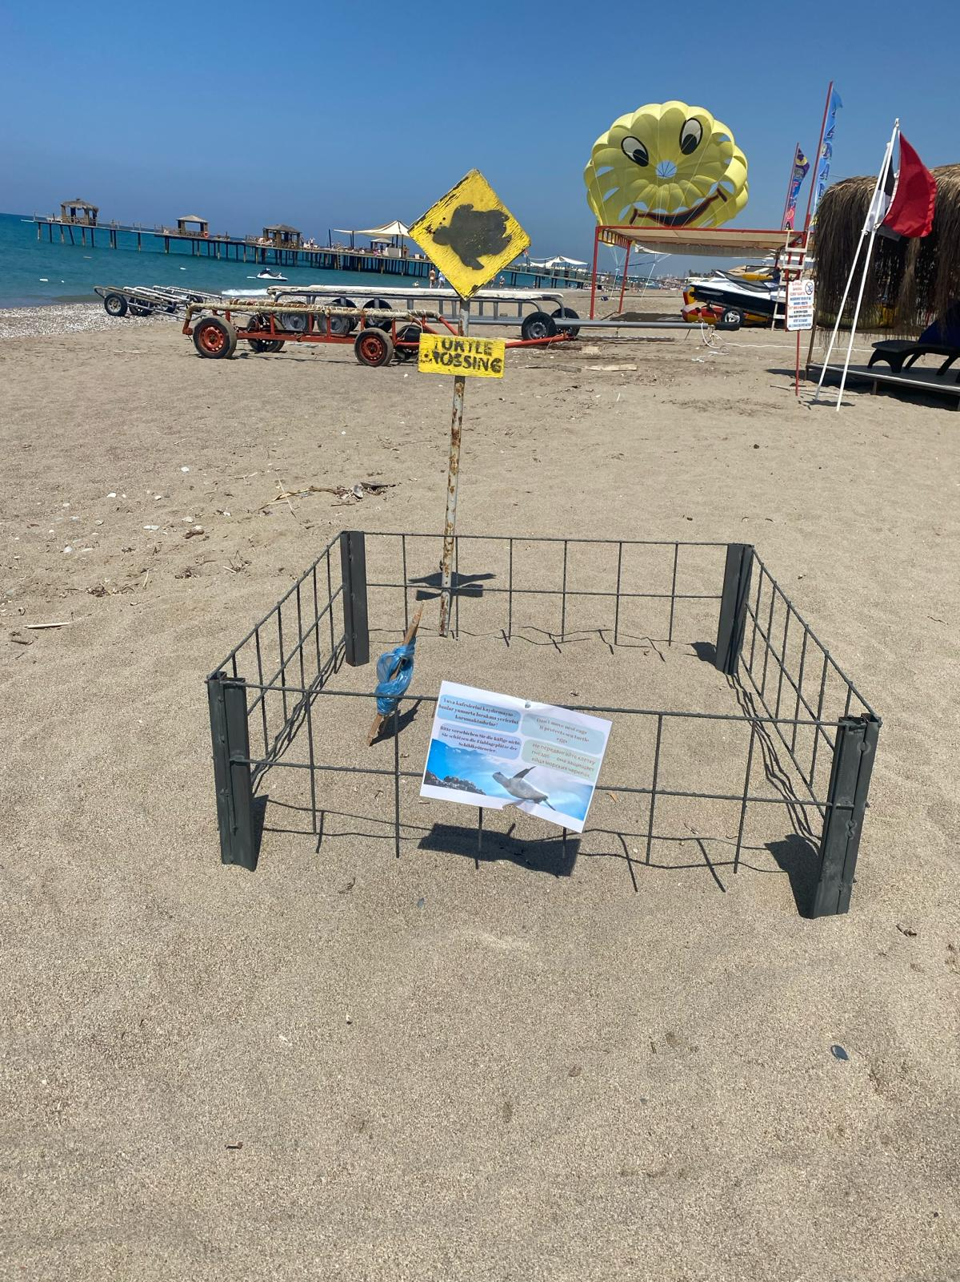
environmental activities ;
The beach of our facility is Caretta It is located in the breeding basin of Caretta turtles. We comply with the sea turtle nesting area rules of conduct and request that our guests be sensitive in this regard.

Slide 26
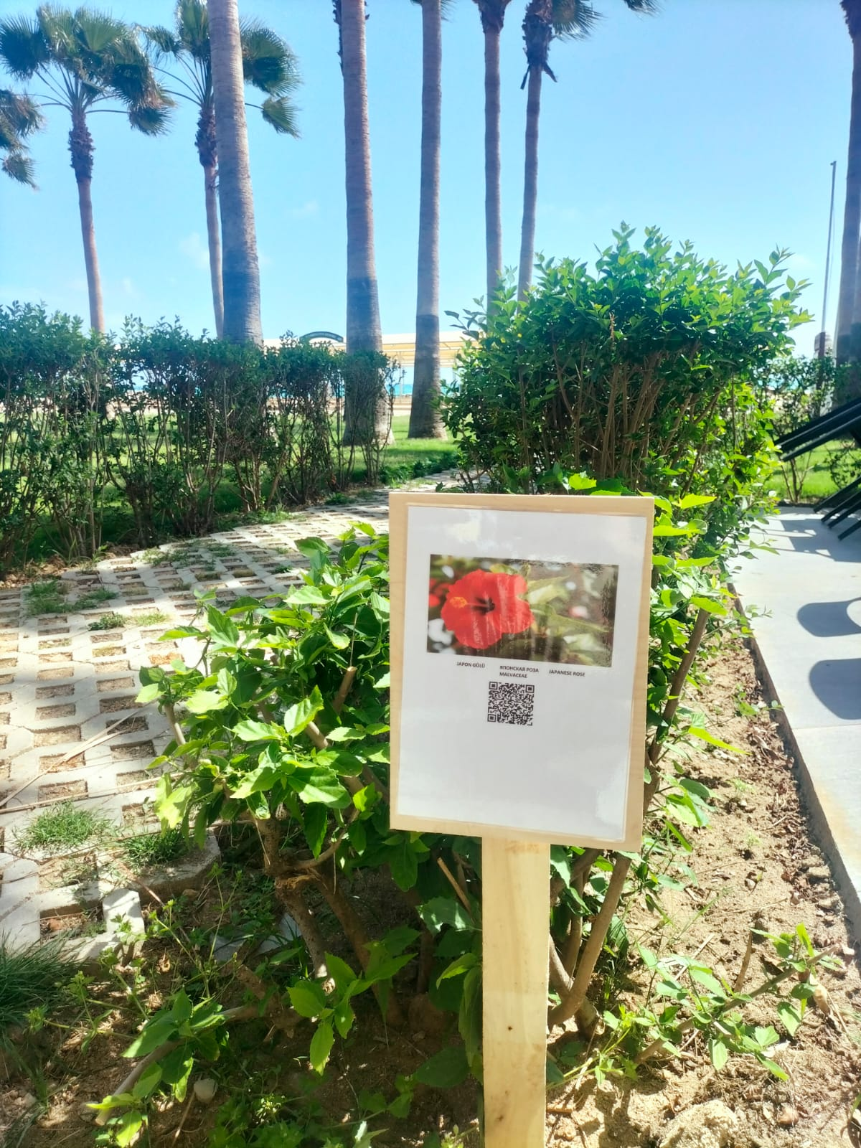
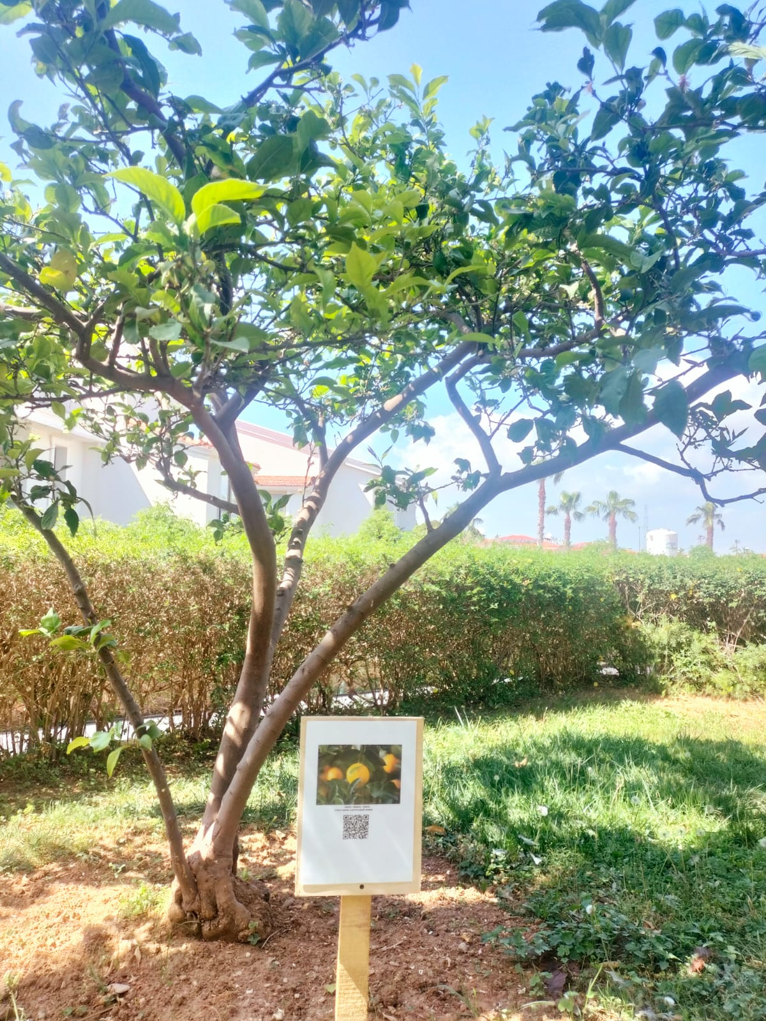
environmental activities ;
Our facility falls into the Mediterranean climate. It is classified as a climate with hot and dry summers and warm and rainy winters . We pay attention to the diversity of plants we use in our landscape to contribute to the biodiversity of our region . We also raise awareness of our guests on this issue .

Slide 27
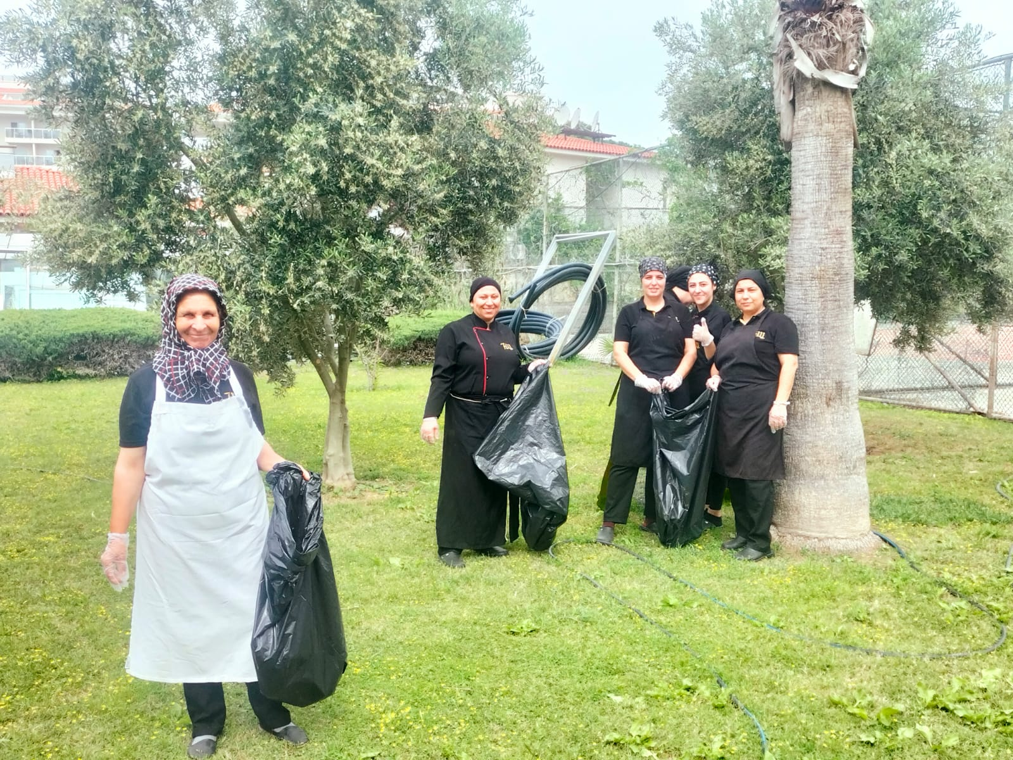
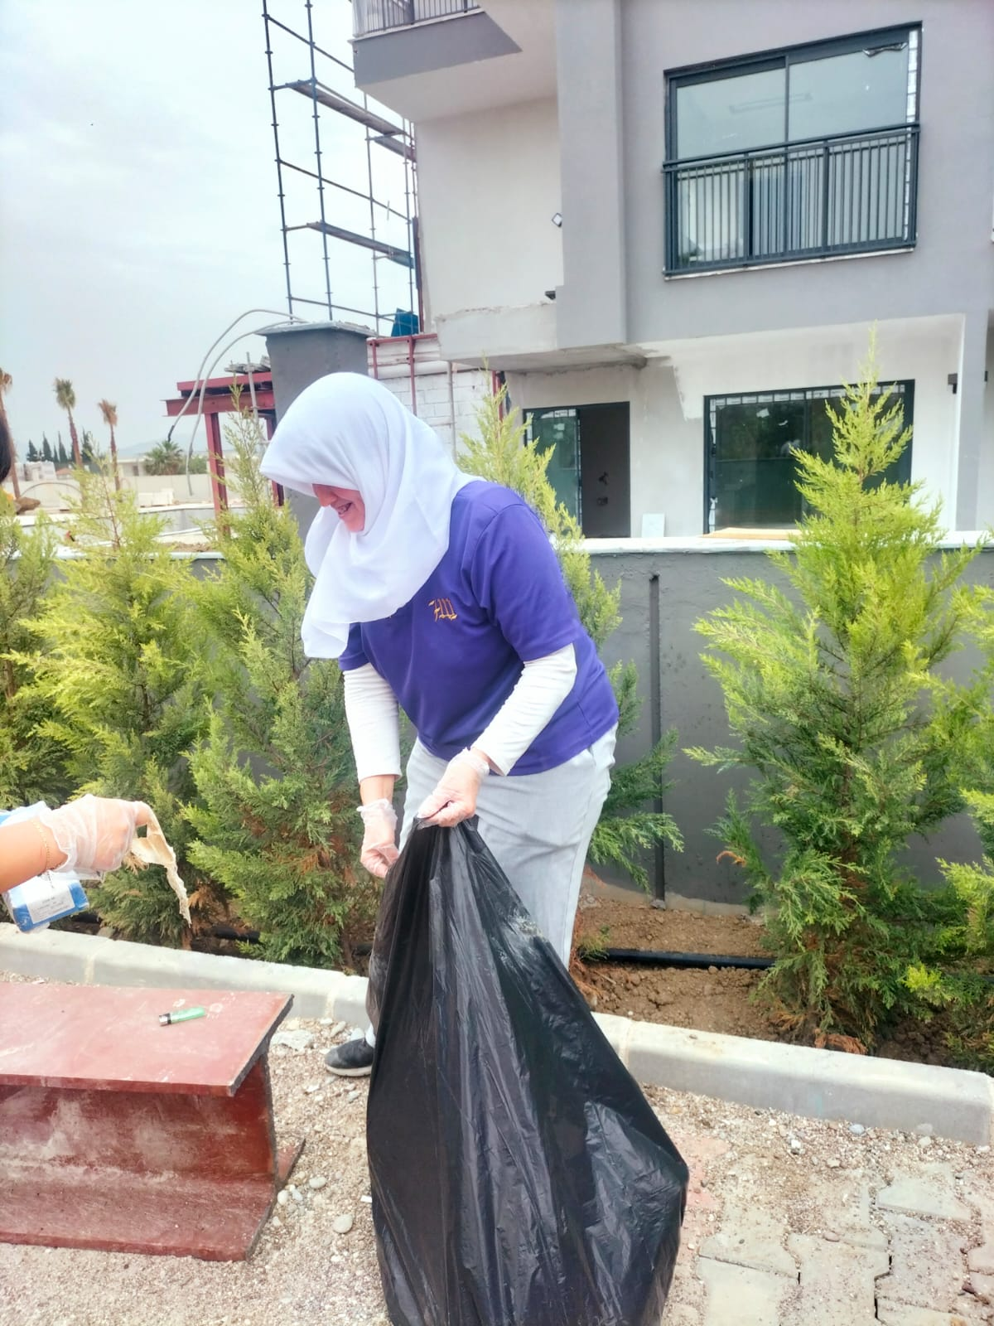
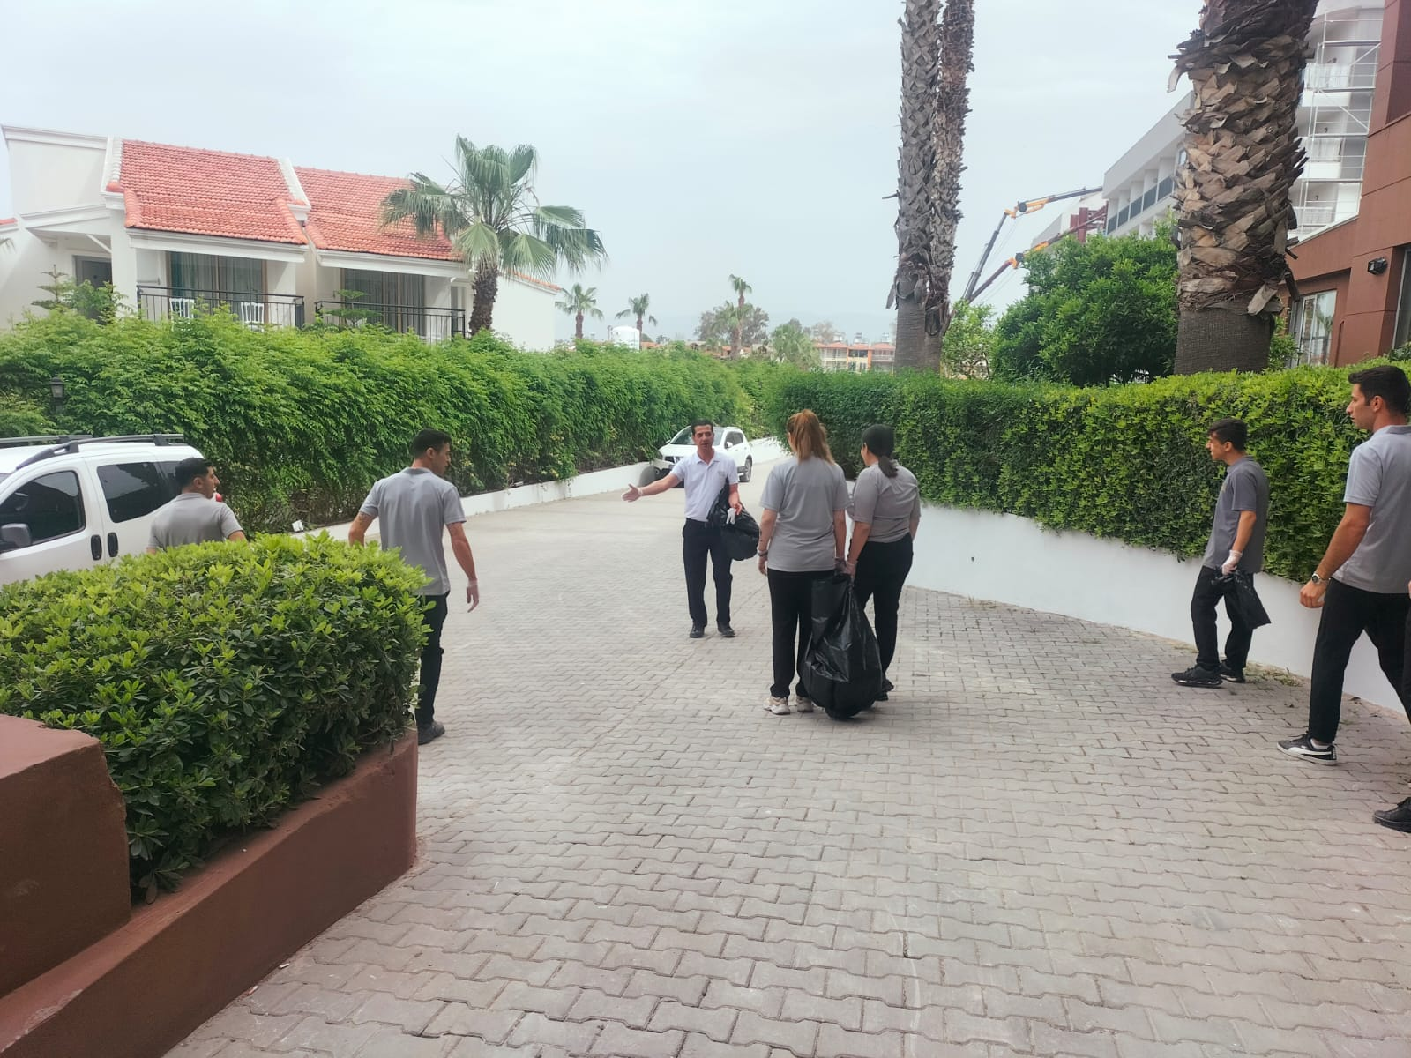
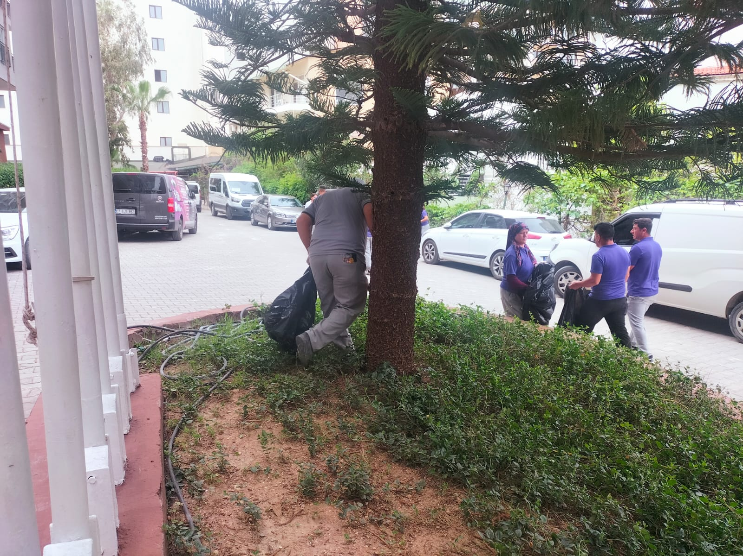
environmental activities ;
The beach of our facility has a blue flag. Environmental events are held within the scope of the blue flag and we invite our guests to participate in this event.

Slide 28
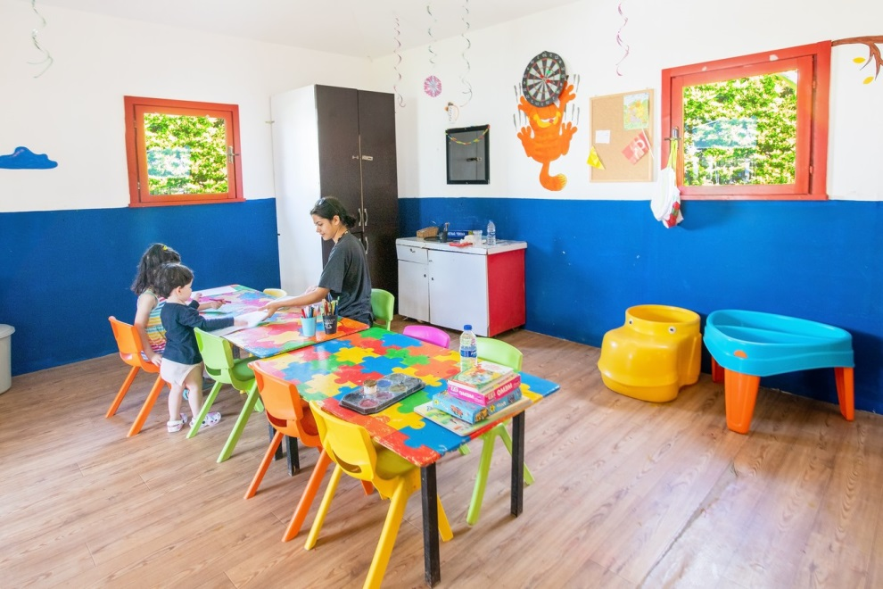
Children and Individuals with Special Needs

Slide 29
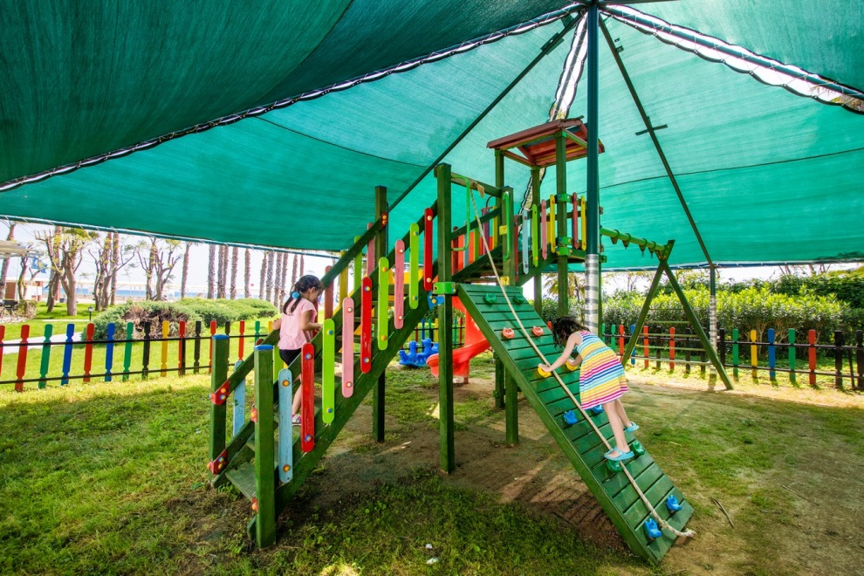
Children and Special Needs Individuals;
our children can spend time and have fun safely .

Slide 30
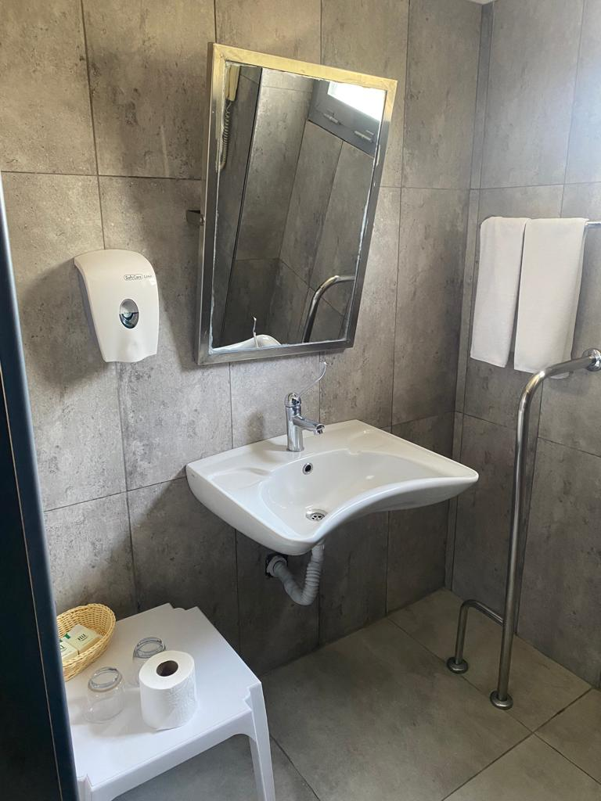
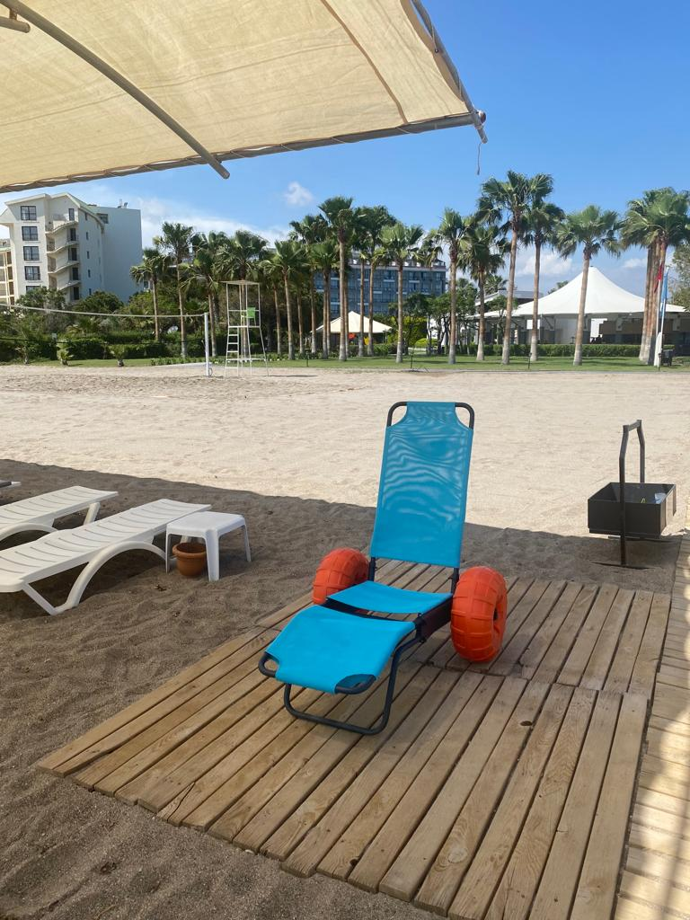

Children and Individuals with Special Needs ;
Our facility has special needs There are 4 rooms for our guests, disabled WCs in the general area , ramps that they can access from our facility entrance to the beach , an elevator, a pool elevator and sunbeds.

Slide 31



The value we give to our employees;
In order to motivate our employees, birthday celebrations are held every month for people who have a birthday in our facility. At the same time, the employee of the month is selected and rewarded based on that month's performance.

Slide 32

Benefits provided to the people of the region;
Our facility supports education at Kızılağaç Ünal Akpınar Secondary School in order to benefit the people of the region.

Slide 33

SUSTAINABILITY REPORT

Slide 34

Sustainability Report
Electric
Electrical energy consumption per capita is calculated as 14.37 KWH in 2023.
The air conditioners in all our rooms were renewed and the VRF system was switched to, and as the pool volume decreased, new circulation pumps were purchased and energy savings were achieved.

Slide 35
Sustainability Report
Electricity Saving Practices ;
Meeting room lighting is divided into sections and the lighting level is increased or decreased according to need .
There is a sensor lamp in the section where public toilets are located, thus saving energy .
There is a card system in the rooms, and even if the card is inserted, the heating/cooling system is turned off when any window or balcony door is opened .
sure that all the devices we purchase and will purchase are A+ class .
We regulate the operating hours of air conditioners in our general areas in a way that does not affect guest satisfaction.
When choosing lighting, we give priority to " LED lighting" products.

Slide 36
Sustainability Report
LNG
0.10 KG was saved in LNG consumption per capita compared to 2022 .
Our facility uses solar energy as a renewable energy source. In this way, we preheat hot water and save 23.80% on LNG consumption.

Slide 37
Sustainability Report
Diesel
per capita in 2023 was determined as 0.05 L.

Slide 38

Sustainability Report
Our Water Risk Map

Slide 39
Sustainability Report
Our Water Risk Map
World Wildlife Fund pointed out that Antalya is on the global list of cities with high water risk, so while we carry out our activities in the management of water resources, we must stand against approaches that ignore nature and unsustainable practices and do our part. Therefore, we have to raise awareness and contribute by providing the necessary training to our staff and the necessary information to our guests, and we carry out our activities by protecting our natural resources, especially in our country that is facing drought .

Slide 40

Sustainability Report
This
water consumption per person in 2023 is calculated as 0.44 tons. The reason for the increase has been investigated.

Slide 41

Sustainability Report
Water Saving Practices;
The rooms are equipped with a water-saving aerator and shower head .
Garden irrigation is done using the spring system .
In coastal toilets, there are two buttons, small and large, on the cistern push button; the small one consumes 3 liters of water and the larger one consumes 6 liters of water .
public area sink taps to prevent water consumption .

Slide 42
Sustainability Report
Chemical
2022 , our per capita chemical consumption rate was calculated in kg and determined as 0.63 . This rate has been reduced to 0.38 in kg per person in 2023.

Slide 43

Waste Management
We do not support recycling by separating waste on site, and in this context we work with licensed waste companies .
We deliver our waste, which is sorted by
We deliver our construction waste to relevant institutions .
in our rooms for organic and recyclable waste, and we include our guests in waste separation.

Slide 44
Waste Management
In 2023, our per capita plastic and paper waste rates have decreased. It will be investigated why the increased consumption occurred.

Slide 45

Waste Management
We aim to reduce our amount of plastic waste by using refillable
plastic straws to our guests upon request , thus aiming to reduce the amount of plastic waste.

Slide 46
Guest Satisfaction
Our satisfaction rate in 2022 was determined as 89.90%. Our satisfaction rate increased in 2023. We expect contributions from our guests for sustainability practices in 2024 .

Slide 47
Our Contribution to the Regional Economy
62% of our total employees in 2022 are local people. In 2023, this rate increased by 75.05%. We aim to increase the employment of local people in 2024 in order to increase our contribution to the regional economy.

Slide 48
Our Contribution to the Regional Economy
the Manavgat region in 2022, this rate has increased to 55% in 2023 .

Slide 49
Consumable and Disposable Material Consumption Amounts
Our per capita consumable and disposable material consumption amount is given in the chart on the side.

Slide 50






TRAININGS
Within the scope of sustainability, our hotel
Child abuse and harassment training
Behavior training for disabled people
Environmental awareness and zero waste education
Sustainable tourism general awareness training
Promotion of natural and cultural heritage
such as have been held.

Slide 51

WE THANK YOU.
For your feedback and opinions, you can visit

